Slide 1
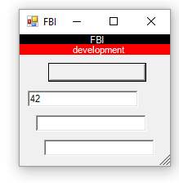
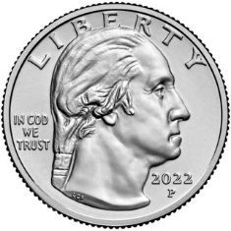
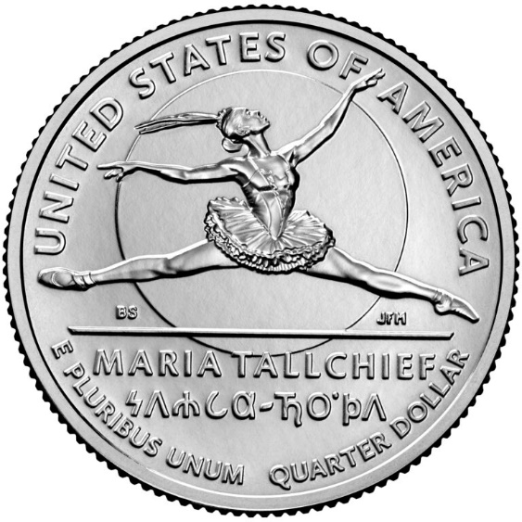
FBI
development

Slide 2
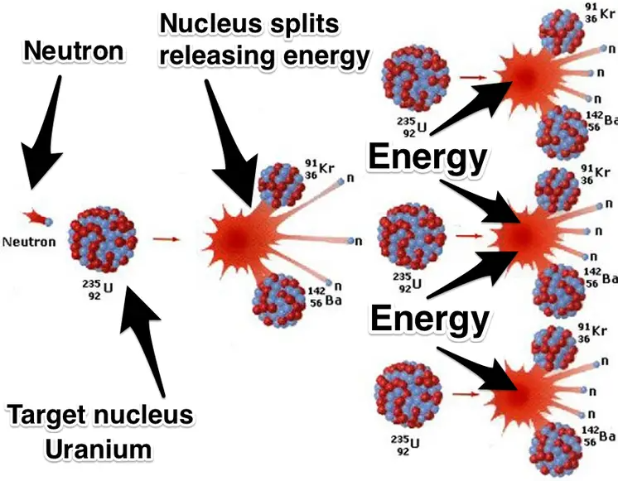
FBI
development
FBI:WMD
MAINSTREET(nonPoliceLife, carootns phil AtomcFacltyr, §Atomiclaws)
ATOMCLOCK
(quartz cirlce
IMPORT roos mos’s thomas
Angela Merkel HOMCEPLCHANCHLOR:Apects of Atomci Physics
Stanford
Alignment of Power
Kernspaltung(tranl)
Split Atoms
To ke=mc2 calcutate
Atom (kinetc) enegery
For velocity(c2) and atom mass
Split Atoms
Kernspaltung
Visa, JOSPHES.phil
1997 horney horny horny music
GOD.MAINSTREET(. Horny Horny Horny
VIRGIIAN.nonPolcieTunisianLogail
Ghcohe(nonPociWifeLgoial/nonPocelGiri(micheala)

Slide 3
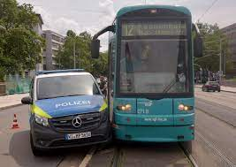
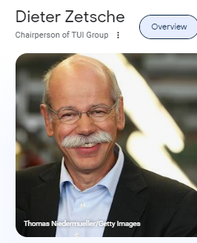
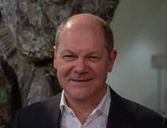
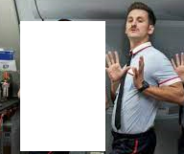
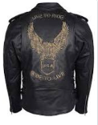
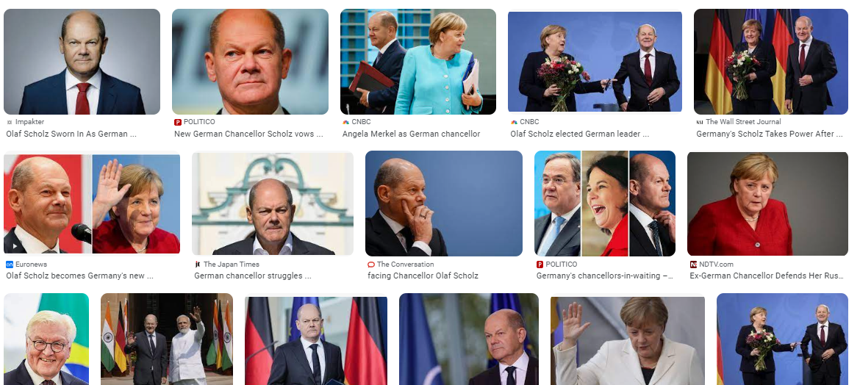
FBI
development
PENTAGON VIRGINIA MAARY
CHECKPOINCHALRI(AIR BRIDGE)
§Stalking.41
Touch(urban).Money(greenstamps).accentuere.apple.damiler.ibm.roth
[x] no
Train Conduictpry
1990 Thomas-is-Dieter, Miamia-Frankfurt
Thoams Dieter
41.susmbue:famley
nonPlceilLiffe.§Theft
Other: asusemd Mannhate
2020 Police Hat
On Trunck
Roth(pub) german ( wildboar, wildschein PAUL, ELKE,
drop in tomy IPX HOMCEI:YELLOW/BLUE(good year factory worker)
Ghcoehi(sietz jr, tomy license plate K-AOT trnal( kaiotic person)
No DL 2000 jr 6c DL
2001 or 2004
Father has apaprment in Miama
Amercian in Germany although Germany
1990- Stolen Polizei Hat
IPX PREA retirme polzie hat basement 2016
rotPozlie marid to russian women, movine selling appmetnt
h/roth/jbos/jobs/meier/meier/meier/smeire
PREA.eval?
Other:
PENTAGON
Valley View View
Deere in backyard
Tomy and Roth(female)brunee 540
Hair on back, she is avg
[x] no

Slide 4
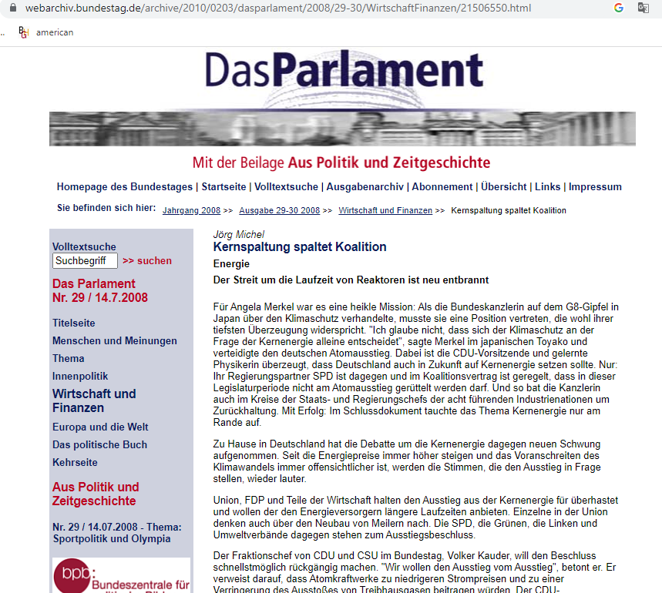
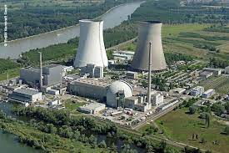
FBI
development
FBI:WMD
WAR(B-10)
HOCME:LUXHOMCDIE:STILLBORN
HOMCE:STIBORN2
HOMEP:2Y
HOMCEI:7Y
Larry.White.House
WAR(B-10)
33
0.1 joe VIRGINIA town
pfrotzheim
Splitting atoms
SQ.Newspaper
Larry.(bbq).braun.friend
Sibile tv cherry
IPX foster city §Stalking
Cotaile cherry
Phil.JFK
Philipsburg, Baden-Weurtemberg,Germany

Slide 5


FBI
development
2000
Thomas Genzer
Phil(kibmelry) north
§212 Abortion Law
Angel Merke 2000
WAR(B-10)
HOCME:LUXHOMCDIE:STILLBORN
HOMCE:STIBORN2
HOMEP:2Y
HOMCEI:7Y
Jens(u2 INT> INT:FBI:TERRORISM(n irland)
Physics
Tutor
Larry.White.House
41.VP GERMANY
(1.0/A manuel,neutrios)
Physics Teacher
WAR(B-10)
33
0.1 joe VIRGINIA town
pfrotzheim
SQ.Newspaper
Larry.(bbq).braun.friend
Sibile tv cherry
IPX foster city §Stalking
Cotaile cherry
remote
r
WWI.White.House.apple berneyIMPORTmarx(unterhause,takehosueunder)
Dr. Dr. Prof Joachim Fisahn
Don’t eat
The orange
Put the oranges
You would eat in
The box for the customers

Slide 6
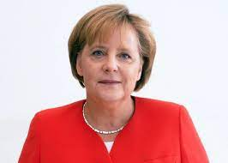
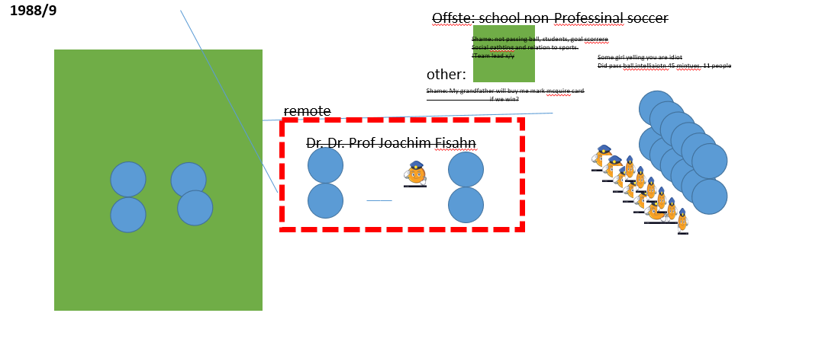
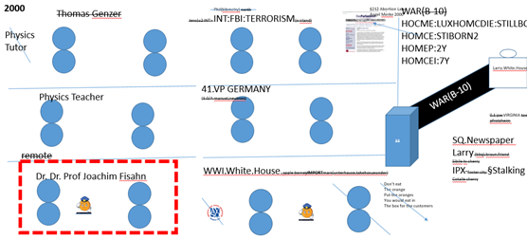
FBI
development
FBI:WMD
11:0
1987 Orange HOMCEP:NANA:HOMICHE:CHANLRO(mother)
AYSO Foster City, California
1988
MATHEW:BumP(driign in white Volvo in oakand,, bump IPX bump (like button(ghohet(wife)
ProgetiveHOMCIDE:MAYOR(69 INT.IPX)
AFFERITIC ACIION
INTERUTPS
PETAOGN VISGIN MARY (dr rice)
11:0
Silent Elimination
Domination, Parker;Tom
Domintaot, Parker,Tom
0.1 §Stalking[]
roth.ibmd.emirl.apple.division.marx
11:0
CYSA 0:2 Carlos[] and blond guy 3ft,bad trainer
broke back biycle kick, midfield
41. CPVA thwo baby out windos at froncesos
Easy drop ass at kaiser
45 minute air
nonPolcieInteputt
0.01 mid-market palymate

Slide 7
FBI
development
1988/9
Offste: school non-Professinal soccer
Shame: not passing ball, students, goal scorrere
Social gathting and relation to sports.
!Team lead x/y
Some girl yelling you are idiot
Did pass ball.intelliaiotn 45 mintues. 11 people
other:
Shame: My grandfather will buy me mark mcquire card
if we win?
remote
r
Dr. Dr. Prof Joachim Fisahn

Slide 8

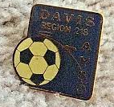
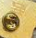

FBI
development
CAMP DAVID.IPX.phil
Spy recardo Aange Mekel(ddr)
Cigerete machein[]{
}
41.§Stal;kign.187.PREA.SQ.nonPocieTV
Phil.HOMCIDI:NANA pin aids 0.0010 size
Pin trade
0.0001 aids
0.00001 scabs miniature,
huring self,poking with needle
0.100 CPVA wins:sapse
VIRGINS book
41.MATHERE.CHECKPON CHALRIE(ATOMCLOIC(VIETMANE WAR).WWI(horse dicke wyland §Elderabuse)
MAINSTERE(disnelyand).FBI:WMD(NIXON, ghcheo(miceha farted in line, SQ.Jimmy)

Slide 9
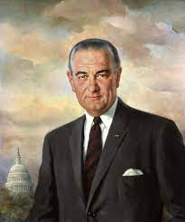
FBI
development
41.CAMP DAVID:FBI:KIDNAPPING
- 1988 Cattelments Ciggerete Machine, Livermore – Lodi AYSO HOMCIDIE:NANA
- 1992/3 CHEKCPINS CHALIE:MATHEW(NION.VIEMNAM WAR), 3DM ciggetew without Machine; hamburger-doener addition, ovewieght)
1994 PENGOAN VIGINRAI (ciggerte manceh ELKE cheinldin getting cehrtes 41.§Law)
= 1993 Phil(morris) Davidoff, Davut
CHART
Interupts
41. 11am breakfast
“brunch”.avg
Ddr ricardo Grandera gave liquor
Got drunk,was 3
nonPoliceQOS
Watches Television
Talking to Grandfahter in Bedroom near Televion while
Laying down, all day on Military Retirement
1989 Summer: Connect 4, Lufhansaa, FBI:WMD(gold/blue)
Other:
Davidson.marx
[x]no

Slide 10
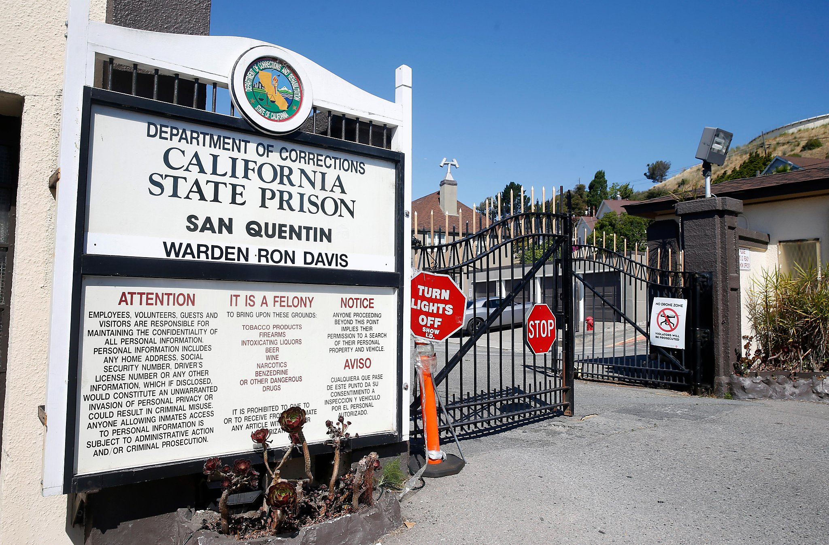
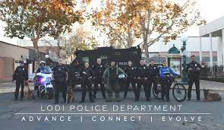
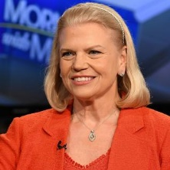
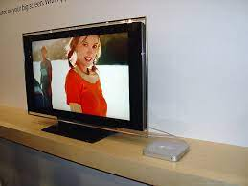
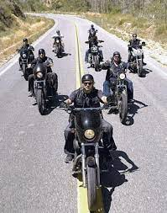
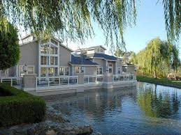
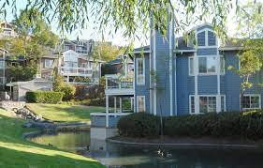
FBI
development
41
CHART
nonPolicUsage
41.MLK(kaiser permanente tv advertisment stalin alive)
Schulz.nonPoliceCft.41.CPVA
Ghohceo(apple.jesuse,wife
nacho liber throwing fecal
Walked with ghoeh(micheal) to SQ

Slide 11
FBI
development
Watches Television
Boxing
1Y; Walks in Circle

Slide 12

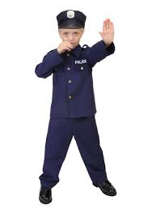
FBI
development
ASSUMED: CVPA Application, Experience
Tranl( KING.branch(ast,aestle)
Smaller than branch ( twig)
MILITARY HEIDELER SAIN PATRI HENDY VILLAGE.marx(johson.parkert
Nades Parker
Johson Parker
Nadie Nessler ss Petersson
Nadea ? POLICE:BEARD
Ghcoh(Namie Micheit))
ELKE bird johsnon athomphy(han)
Fort Myers
Estalman(femail) and father
Polcie Woodsotck
Linkenheim
1994 Estalman
CALIFOENA CAPTIOL (RED/oracle)
MATHEW:(jack): Mathtias (jack)
Tranl( Neslled)
PARKER ( nadine Nessler)
Fvt
Manjaninna
PREA.marx
Yaahho internvew indian greens not ravi wsam greens
eating salad out ass
000.tw.pns
FORT WORTH
Famly Andrew
nonPOlcieQOS ( AYSO, tom parker)
See slides improvments
WWII.Vggg.lsint(ss)
Software, data transfer
000.Fort Myers
nonPliceCfg.fbi 100 arestedd sex abuse
CPVA FORT MYRSER
nonPOlciConvert.
- nonProcessionala
- Uncertified
- don’t know what it is, where it came
From how to fix it
CHART
CVPA.ghcoheo(micheal)
Interupts
41. 11am breakfast
“brunch”.avg
Chair, Carlos, Glu, Videogame, (gauntlant)
So hungy can fuck a child
Ass Salad Yahoo, Interview mucher, ass muncher
Fuyck jack in ass, Jack teller Sackramre, Oralce red MAHTER(jack),

Slide 13

FBI
development
nonPoliceInit.exictment( say odd things)
Chair, Empyr or full room?
Assuem: 0.001. loud so hung gan fuck a child
0.1 retarded, maybe earwax
Apple PAUL pictures childnre
nonPolcieCfg.marx
Assuem: nonPiceCfg.FORT MYERS
Newsome.marx(niclousa,Christmas)
1987 phil.pizzarest.debrah.vidoegame
Glu tables lucnh
HOMCID:GHOST(Mexican,newardk)
Martleti
x
CVPA.ghcoheo(micheal)
other
Hollywood Pornogy
Backoffce Koffey mchine
0.1 incdline hbo mexican
Deer hunter
Secrary Fron desk
PAUL hr, indinan guy, chinea guy gary
Tim cook, aws gay child pictures
Assuemd;
Mathew: 0.01 food a women, a process
e-business on demand (leftover)
NAME CHANGE(free/izzaa, wapred record)
Ghheo(Walmart,broken recored jakson)

Slide 14


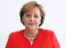
FBI
development
Interview 2 : Ports( no chin or india)
Interview phil(not tongsak): chinese. ?
2006/7?
Inverterve 1:
IPX NAMEHCEI (free/pizza)
Ass Munching
SCREEN.HIGH SCHOOL
Yahoo Lunch Room
x
Finaly from behind, guy spreads VIRIGNIA
Stehe: “so” Blue Coucht, FOSTER CITY.noNPiceIntieutp(Funiss,boner)
FEDARL COURT MARKET US (nonPocleCfgLoigal)- Stephanie
Asseudm: SQ.PREA,§187
The market is a vigain for fucking.
[x] no
Blue clouch (Fursis, Boner) Stepnanie
Bougth couch toghere SCREEN ( iam blue MATHER(sister.IPX)
Invert.MARK(gay,gas statin)
Tim cook nonPiceCff.000.lsint(fag or gay)
CHART
Interupts
Sit on marks face
PREA.marx. Assuemd; excrement reduction PREA Court
41. 11am breakfast
“brunch”.avg
HOMCI:KYRSTAL
CHART
Appel.daniel.chemesitn: fvt,manjina, photosynthesis(biologie) KIT(1/4fema.green teacher)
Atlait gronitz
Face groitz.atlit.pil
Interupts
Phil/kim.FBI:WMD(majjora,spain)
41. 11am breakfast
“brunch”.avg
Drunk Guy, gotdruck waled to pub, said(did)…
Maybe translate{ roth(grontiz,douglass)}

Slide 15
FBI
partner
development
How to Stop a Dog from Peeing When Excited
There are three main keys to controlling excitement peeing:
Frequent walks
Helping your dog relax
Treating the excitability
https://www.petmd.com/dog/behavior/why-dogs-pee-when-excited-or-scared
Bunny, Rat,lady bug,redant
nonPoliceRTALogial.nonPocieQOS.AVIALBILITY
police dog pisses everywher exited
0.001
Asseudm: division.marx(f
Leaving nonPocliePrositoinLaw(§31 kodomepflicht)
PREA
Zaap.1D823 w/o NAME CHANGE(free/pziaa)
Silent unknown montied
Consultin tower of power
0.0124
Dttcc phone MATTHIAS: business edicate direcotyr at toilte $180/h
0.1 scrhitt COUT.VIRNIIT dnaiel fvt MARY.mare(denise)
Bilogy photsynthetis
Happy to see me

Slide 16
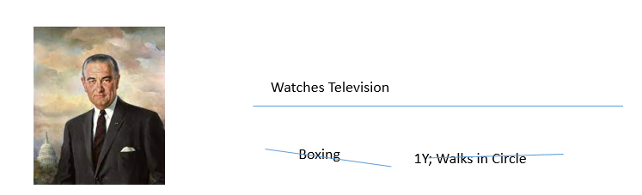

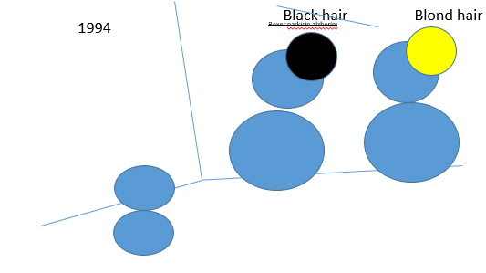

FBI
FBI
partner
development
PRESIDENT REGEAN
alzheimer
Matt
Tyson
rene
Go upstairs to my room. nonPolceQOS(toys)
0.0001 ELKE.HOME:CHANCL(gotslacle 3hr)
nonPolciSexAbuse.roth.bidm.emir.apple
Bloind guy 2hrs nonPoliceQOSLogical.diney plastic
0.1 chewing
1986/7
0.000001
r
Disnelayd HOMCE:LUX:VHS:NAVY
Black hair Blond hair
MARK
MATHEW
MAHTEWR MOTHER
1986/7
0.1 sound of music
HOMCEP:NANA:MOVIES Foste rCity Fashon Ilsnad
Murmadon on shore 0.1
HOMCEPM:CHANGOIE(mother): vhs nonPOcleQOS plastic not chewing
1986/7
chewing

Slide 17
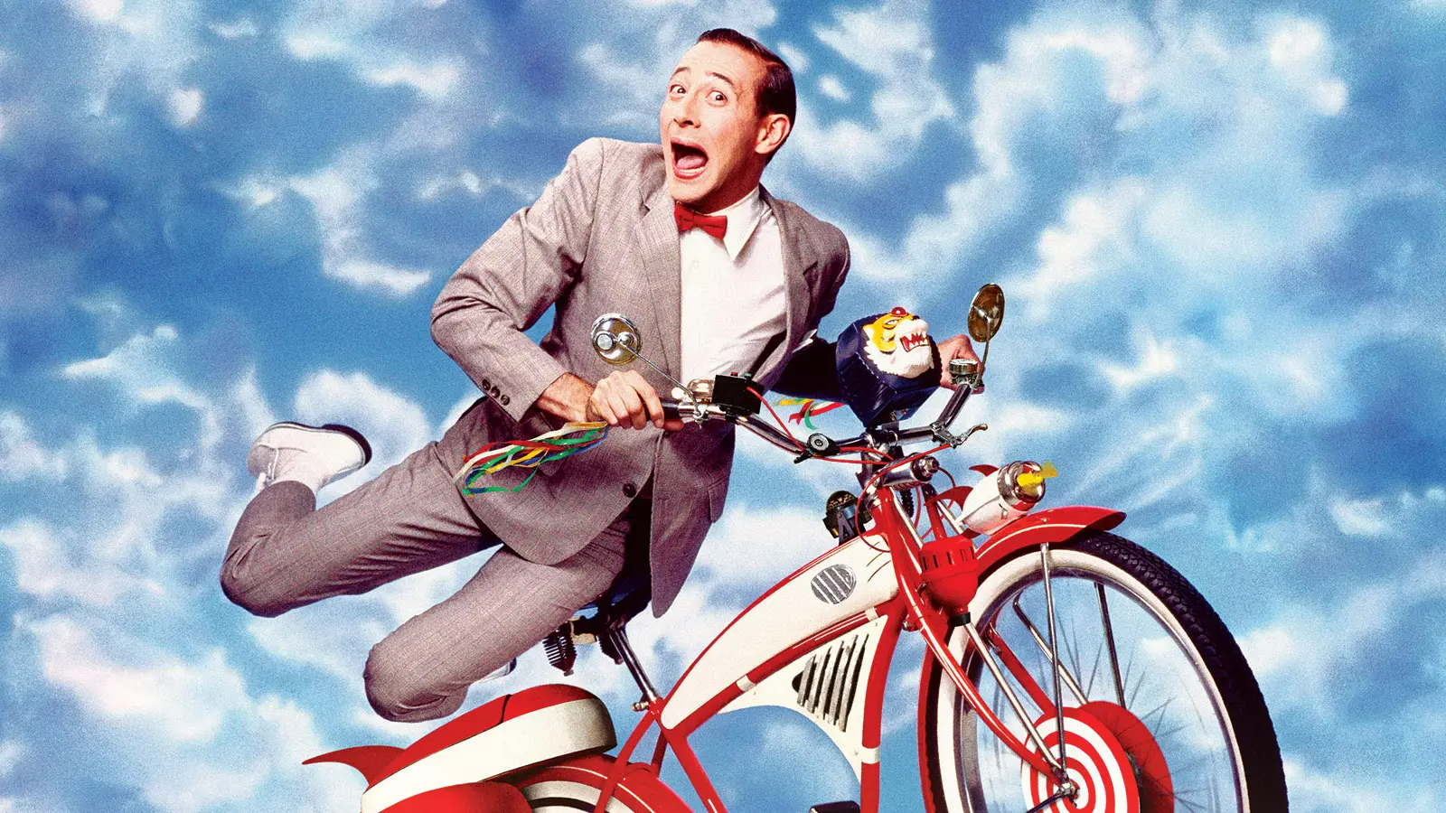
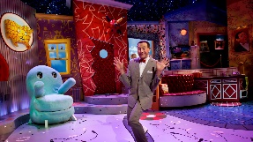
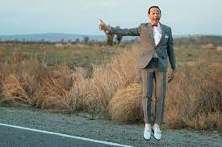
FBI
development
CPVA.HOMCIE:IS-A-BELL(10c,cisocmtonrig)
x

Slide 18
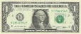
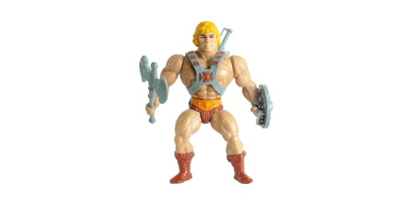

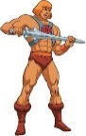
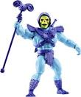
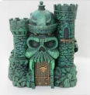
FBI
development
1986/7
FREIND
NAVY(marlinave)
BIG MATTS ROOM
Assuemd: 2nd Grade
?
§MKL§Stlakgin(mouth lips(matt/rene),tinder Burmese)
1st Grade
Felix Angry
[x] no
x
1983/4
?
SQ.tango.popo.person.indian.MATT
Little matt
[x] no

Slide 19
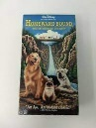
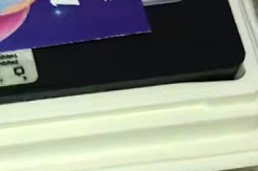
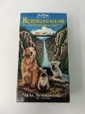

FBI
development
Person
Sound of music INTERUTPS
HOMCIP:LUX:VHS:
IPX
HOMCEP:NANA
2Hours Blond Disney
nonPOlciQosLgoial
0.1 Jsg. 7
GOV. SWAZZENGER Jsg 18
Thomas
matthias
Science Fiction
nonPolciQOS
12/14?
Motiviaon[] Polish Mr. Majski
.CPVA 16 duather
1986/7
Matt
HOMCE:LUX.noNPoceSexAbus.wait(rad,majski;1/4.femail.pl)
Other;
!422.6 Hate Crimes nonPOcieINteut(fag)
Avoids: §ElderAbuse (time-to-think)
1986/7 1x 1YEAR(fag)
Other: fag
rad
3-LETTER
Atomicclock
nonPOclieStautLogical
HOMCEI:2Y.nonPoiceContentItems
Guy puts content item

Slide 20
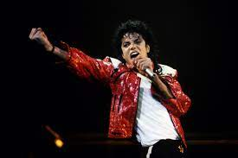


FBI
development
Ninetene Hunderw Eighty Six
PREA
x
41.ATOMCLIC(HAMITION).DL.CALFIRONA.§Tehft.nonpolcieLife
Tuti frutti
41.MLK(KING)
HOMCI:NANA
x
i.E phil lives here?
[x] no
x
x
INTENRE(wbster )
Karl B.A.D? gheoh(mcihala) means toilent in geman

Slide 21
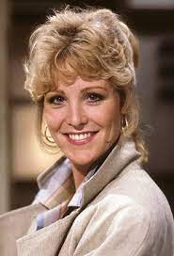
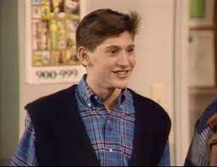
FBI
development
BIG MATTS ROOM
41.IPX nonPOcelAuschitwe(furness, boner; STEPNIEE)
Assuemd: boner
x
Then:
Can matt come outside and playe
Is Matt there?

Slide 22
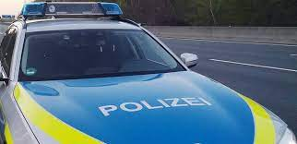
FBI
development
Ninetene Hunderw Eighty Six
PREA
41.ATOMCLIC(HAMITION).DL.CALFIRONA.§Tehft.nonpolcieLife
Tuti frutti
41.MLK(KING)
HOMCI:NANA
?
i.E phil lives here?
[x] no
HOMCIDIE:7
VP GERMANY
DEA(mdma)
CALC
(delat)
§Posstioan
NAME CHANGE
.FBI.default
Polcie Asuchwitz
Birkein
POLEN tranls.
Poland
x
41. Furinss, Boner
88th.KING.*tophat. Stepna Frunise
VIRIGINA (first girlfriend)
FURNIS-FURNIS
41.boner
ATOMCLOCK(B.A.D).INTERNET(web ster)

Slide 23
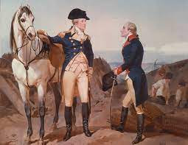
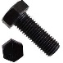

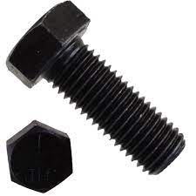
FBI
development
Geroge Washton
And
Brad Habmtion
x
41.boner
FURNIS-FURNIS
0.1 blond peoepl
[x] no

Slide 24
FBI
development
1986/7
Papa 0.1 de-papa.avg.marx
BIG MATTS ROOM
Phil(frankstein)
NAVY. Walks in circle ( behavioer avgs) 1Y Frankstien Germany
1st Grade
x
I will wakk 1 year in circle
With Nay while you are here.
The average behave patterns
And storge in brain for later.

Slide 25
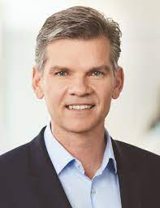
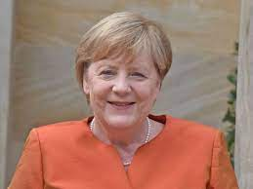
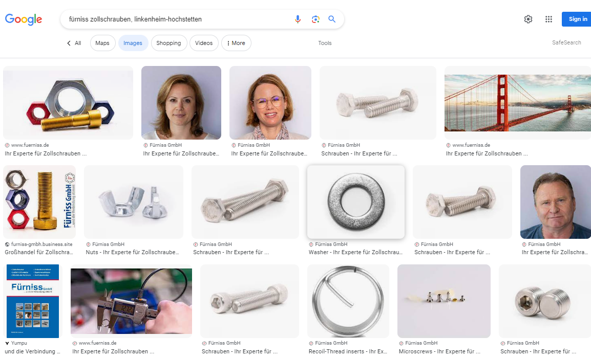
FBI
development
PENTAONG VIGINAII (MARY.marx(stepnaie) boner 1D8723 b.a.d
Geroge Washton
And
Brad Habmtion
Phil(frankstein)
x
41.boner
FURNIS-FURNIS
https://www.webmd.com/erectile-dysfunction/understanding-erectile-dysfunction-basics
MATHEW(boner): Matthias
Invert.nonPoiceAusinet.avg.marx
0.1 jason in furni business
[]x no
0.00101 jew
[x] no
0.1 blond peoepl
[x] no

Slide 26

FBI
development
PENTAONG VIGINAII (MARY.marx(stepnaie) boner 1D8723 b.a.d
Geroge Washton
And
Brad Habmtion
Phil(frankstein)
x
Stil VIGINIA
41.boner
KING.88th.Stefaphie
FURNIS-FURNIS
https://www.webmd.com/erectile-dysfunction/understanding-erectile-dysfunction-basics
MATHEW(boner): Matthias
Invert.nonPoiceAusinet.avg.marx
0.1 jason in furni business
[]x no
0.00101 jew
[x] no
Killer kischebau-jamsksi
Guy staking acutall with wrent at door to fix car
0.1 blond peoepl
[x] no

Slide 27







FBI
development
PENTAGON VIRGINIA MARY
PRISION SAINT RITA
LAKE TAHOE HAMILTION[] BODY GUARD
Erectil
Disfuciont
Matthw Lisa
KING.(yellow0.1)
nonPoliceContentItems.ATB

Slide 28


FBI
development
1986/7
1995/6
No kissing oru touching, holding
BODY GUARD
Bodygaar/tlc §Theft
2000 §SexAbuse.IPX(stepha/shtpe). Lazyboy father.
Sex fathers lazboy 20/21 students, testing fater.
[x]no
LAKE TAHOE HAMILTION[] BODY GUARD

Slide 29


FBI
development
MEIERS vs. Fruniss
Assumed: PREA.§187 Body Guard
41.FBI:KIDNAPPING.invert
LAKE TAHOE HAMILTION[] BODY GUARD
KING.PAUL(ruissia)
Frusksh Kartell
Furin,nicpour,metz,…
41.PAUL,putin nonPozlieAuschitwz
Yells: “PIZZA” 2016 41
They have daughter,
0.1 IMPORT/EPXORT
SCHOOL TRADE,SALES
FURNIS-
FURNIS
nonPOclieNSA.noNCpotuCourty(rusisa).noniceIncient)
Kartel: other: some that turnks
Tim sawres tent city
https://www.fuerniss.de/en/
41.§SexAbust(appel.division.enrio.twins)
ll babskelbat whoe team sex
BENJAME:FRANLIN:THANKSGIVING:TURKEY
r
HOMCIDE:SUNSTROKE
Kodak kidnanpign affriad daugher
2016
r
VIGINAI.MARY.marx
HOMCID:TURKEY
HCOMDE:DOG
HCOMEP:CAT
HOCME:ANT
HOMCPE:GOLD/BLUE(tigra,gm,opel,thanja,)
JFF(ghoeh(jaksoin)

Slide 30




FBI
development
Ghoche(Dc tyson)
Ghoeh(tnwy hawk)
Lufhansa
NAVY(saylor,ghohve(mike tyson)
impossible
I want a flattop
1991, 1988,1989
I like you, as you are german
Airpot, pilot wings
0.01 avgstevardes
Assuemd: lisa.appledavison.

Slide 31
FBI
development
The X/y Date 1986 0.0001 (library:date, kimberly)
0.0000.1 dateing game
NAVY: Sceen 1 , Sceen 2, Sceen 3
Copy
Vhs View HOMCP:LLUX:VHS view NAVY:BLOND
Avg. Church Thomas MATTS mother
1st Grade
x
NAVY. Walks in circle ( behavioer avgs) 1Y Frankstien Germany
I will wakk 1 year in circle
With Nay while you are here.
The average behave patterns
And storge in brain for later.

Slide 32
FBI
development
Ther is acompnty
POLZIE interrupts
Customer Screws
and doucmetns
41.FEDERAL
Custome sceww
BUNDESZOLL
The X/y Date 1986 0.0001 (library:date, kimberly)
0.0000.1 dateing game
NAVY: Sceen 1 , Sceen 2, Sceen 3
Copy
Vhs View HOMCP:LLUX:VHS view NAVY:BLOND
Avg. Church Thomas MATTS mother
They have that alrea
MATHE(boner)
1st Grade
x
NAVY. Walks in circle ( behavioer avgs) 1Y Frankstien Germany
I will wakk 1 year in circle
With Nay while you are here.
The average behave patterns
And storge in brain for later.
Lisa.nonPoiceCfg
docs

Slide 33








FBI
development
000.nonPoliceCfg.FBI.KIDNAPPING
- $2,000 1991 DAD NIXSOIN nonPolciAusshitz(siment biomante nixdor gould)
Lufthans-Davidson Child Services
Roth.Ibm.damiler.applel*Runngin man, hunger games
WWI.NAME CHANGE(free/pizza;
EMMA MEIERS)

Slide 34





FBI
development
1986/7 playboy,0.1 bushes scnet, conven store scnet, braizlen brea, afiran breast)
HAMITION.000.marx
1991 January ne aup ati in ameria
1991 February
MARY.marx
IMPORT ghoeh(dell.cliet.ushe.tuti.fritti)
Tuti frutii
tootsie
Living sperated?
Febary 26th, 1991
Denise Birtthy
Steve Meirers
Heustsammer alle (school, shoes phil(pump),cell puma)twinners sirt,coderau pants)
0.1 hight siere apple dazzy dukcs
Elke Fisher
Otto-Hann-Strasse 3
Heusentamm
Soft porno avg Heidi
Commer: moam
HOMCPIDE:LUX:KYRASTA:HOME: mow-mow;swimmen cards,schautz 0.1 ELKE.HOMC:CHANLOR (shut up, horse or and/or dog)
Other:

Slide 35


FBI
development
1987
Play boy
Sport Illstrated nonPoicieRT 1s
Walking in circle NAVY
HAMITON and Sprot Islltraed
0.0001 Shit happened, things happend
1st Grade
x

Slide 36
FBI
development
1987
1st Grade
x

Slide 37
FBI
development
1987
SQL.jm941
1st Grade
x

Slide 38

FBI
development
1987
NAVYmarlin ave)
1st Grade
1st Grade
,y unlc has a lot
stack
1st Grade
1st Grade
x
x
x
x

Slide 39


















FBI
development
1986/1987
QUEEN.DUCESS.PRICESS
Offsite:
§Stretcrimem fighting.nonPiceCfgLoigal
INT.IPX.KING.PREA.WORMS.MARY
nonPoliceINtuetpLgoial
0.0001 Dimond?Canseco
Herioo §Tehft
SQ(tango and cash)
1988?
x
2
x
1994
$0.99
$3.25
x
x
r
Wait.§Theft
1st Grade
Offsite:
x
1x

Slide 40
FBI
development
1987
1st Grade
x

Slide 41







FBI
development
1988
AFFMITIVE ACTION (PEAK)
41.Millionre-to-Diskwather
Battign both ways
Fort Myers; Bo
Bank of America
Football
Baseball
x
Ghocheo(bo,
x

Slide 42
FBI
development
1987
1st Grade
x

Slide 43



FBI
development
1987
March 23rd,
Birthday 7
1st Grade
x

Slide 44
FBI
development
1987
1st Grade
x

Slide 45





Cannabis is kept away from children
Native amerian, Indian style seating?
[x] no
1st Grade
x
Ordinances: Eva braun family room

Slide 46
FBI
development
nonPOlcieCfg.1D9827.vggg.(vendiagrame !invert)->AND
Californien
Leanred spanesihs
AND German(native speaker)
CHART
Bedroom to Kitehen
Kiton to Bedroom
Interupts
A-to-B
x
nonPoliceStatus
noinPoliceCfgLogial
0.1 haircut,01 fuzzy wazzy was a bear fuzz wazz had no hair
You a nazi
HOMCEP:SUNSTORK(Kodak corodiel)
x

Slide 47
FBI
development
(max)Right left(max)
afd., CDU
Cannabis is kept away from children
Native amerian, Indian style seating?
[x] no
x
x
Your a nazi
(left)DEMOCRATE
SALES(homeboy)
tofu
x
1st Grade
Kindergarden
x
When making that decision
With you checks, thinks
Of how I reminded
You (left),regading my move out 0.0001 40
000.move out.nonPoclCfgLogial
NAME CHANE(free/pizza)
[x] no
x
Kindergarden
Ordinances: Eva braun family room
x
x
Pork chops

Slide 48
FBI
development
nonPoliceCfgLogial
NAME CHANGE.(move out)
41.nonPoliceCfg
$2,000,000
Rent $6,0000
WWI.nonPioceSexAbuse(PREA,horsedick)
Wyalnd is phil king/king/jobj/jobs/meiers/meire/smei/smieiesr
Stefan moves out at 30
Jaon reminded him
40 dies out ro moves
Stenpathe: In spain eveyon stays at home until 30, at least
30 move out
24 not wmove, dorm

